Slide 1
Using PowerShell To Manage SQL diagnostic manager
Vicky Harp

Slide 2

About Me – Vicky Harp
Product Manager at Idera
9 years of experience with SQL diagnostic manager
Twitter: @vickyharp
Email: vicky.harp@idera.com

Slide 3
What is Powershell?
Microsoft shell and scripting language
Commonly used by Windows administrators
Increasingly common as an automation tool for database administrators

Slide 4
Powershell and SQL diagnostic manager
SQL diagnostic manager provides a Powershell snapin to allow scripting of common activities
Examples:
Listing servers
Adding/removing/modifying monitored servers
Listing active alerts
Managing SQLdm application security

Slide 5
Why Would I Use the SQLdm Powershell Snapin?
Add servers to SQLdm as part of a deployment/go-live script
Turn on maintenance mode before reboot, turn off again when back online
Turn on query monitoring at the beginning of a job and off again when finished
Add/remove users to SQLdm application security in standard permission scripts

Slide 6
How do I Enable the SQLdm Powershell Snapin?
On a machine where SQLdm is installed:
Add the snapin using add-pssnapin
Check to make sure it is there with get-pssnapin
Add a PSDrive using New-SQLdmDrive

Slide 7
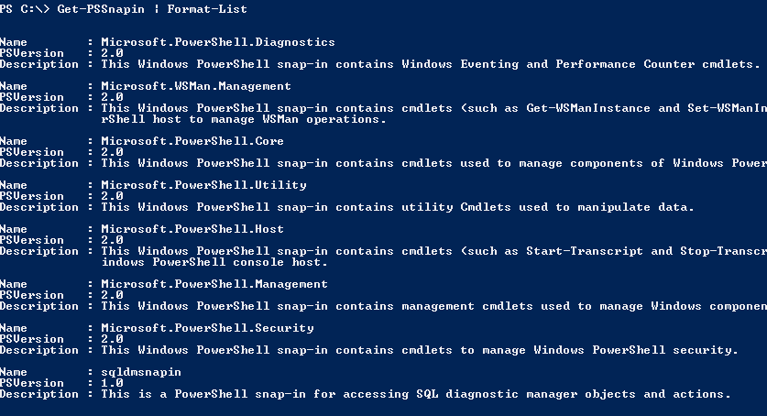
SQLdm Powershell Snapin

Slide 8
DEMO Adding the SQLdm Snapin

Slide 9

SQLdm Drive
Interation with the snapin is through a PsDrive
The drive is navigable like a file path
Different repositories/installations can be added as different drives
Example:

Slide 10
DEMO Adding a DM Drive

Slide 11
Data Available In SQLdm Drive
View all monitored servers
Configuration settings
Active alerts
View all SQLdm application security users

Slide 12
Navigating The SQLdm Drive
Navigate with Powershell or DOS style commands
cd SQLDM:
dir
Set-Location
Get-ChildItem

Slide 13
DEMO Navigating in Console Listing Alerts for All Servers

Slide 14
SQLdm Powershell Cmdlets
New-SQLdmDrive
Escape-SQLdmName
Grant-SQLdmPermissions
Revoke-SQLdmPermission
New-SQLdmUser
Set-SQLdmUser
Remove-SQLdmUser
New-SQLdmMonitoredInstance
Set-SQLdmMonitoredInstance
Remove-SQLdmMonitoredInstance
Get-SQLServers
Set-SQLdmAppSecurity

Slide 15
Getting Help on a Cmdlet
All SQLdm cmdlets expose help text and examples through Get-Help

Slide 16
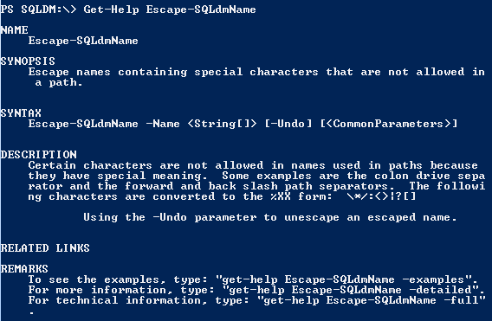
Get-Help Example

Slide 17
New-SQLdmDrive
Used to add a new SQLdm drive
You may add different drives for different repositories

Slide 18
New-SQLdmMonitoredInstance
Add a server to be monitored by SQLdm
New server uses system defaults and the default alert template
Many server settings can be specified when the server is added
Server begins monitoring immediately

Slide 19
Set-SQLdmMonitoredInstance
Most versatile command provided
Set configuration options on monitored servers
37 configuration switches
Changes take effect immediately

Slide 20
Remove-SQLdmMonitoredInstance
Removes a server from monitoring
Use the –RetainData flag to keep data for future reporting
Server is removed immediately
Data is deleted at next grooming interval

Slide 21
DEMO Add and Modify A Server

Slide 22
Get-SQLServers
Helper functionality
Enumerate SQL Servers visible on the network from the running location
Provides lightweight discovery
May take several seconds to execute

Slide 23
DEMO Get-SQLServers

Slide 24
Escape-SQLdmName
Helper cmdlet to escape special characters
Use to escape the slash in named instances and in domain\username for application security
Set-SQLdmMonitorednstance –Path (Escape-SQLdmName “vickypc\romero”)

Slide 25
Set-SQLdmAppSecurity
Enable or disable SQLdm application security as a feature
Set-SQLdmAppSecurity -Enabled

Slide 26
Grant-SQLdmPermission
Grant application security permissions to a user
Grant permission to view or modify a server or an entire tag
Revoke-SQLdmPermission to remove permissions

Slide 27
New-SQLdmUser
Used to add a new user of SQLdm to application security
Set-SQLdmUser to change
Remove-SQLdmUser to remove

Slide 28
Real World Examples
Enabling maintenance mode for all servers
Create and apply monitoring “templates”
Intensify monitoring
Decrease monitoring

Slide 29
Where to Learn More
Powershell.com
SQLdm Help http://www.idera.com/help/sqldm/7-5/default.htm#SQLdm/Use PowerShell to Manage SQLdm.htm

Slide 30
Thank you!
Twitter: @vickyharp
Email: vicky.harp@idera.com
Support: support@idera.com

